Slide 1
CITY UNIVERSITY
Project Name
“Hospital Management System”
Submitted To:
Richard Philip
Senior Lecturer
Department of Computer Science and Engineering
Submitted By
ID : 163432577
Name : MD SHAHIDUZZAMAN SAKIB
Program : CSE(Eve)
Batch : 44th

Slide 2
WHY WE USE HOSPITAL MANAGEMENT SYSTEM
Anyone working in the Medical Industry whether a Hospital or a Clinic or an A & E will tell you about its perils and why they need a refined hospital management system. The workloads, the medications, tests, grieving parents and relatives and add to that aging populations with complicated ailments and diseases, hospital employees struggle to cope with their daily tasks and yet they perform their duties with a smile.
“We find heroes, not on battlefields, but in hospitals that tend the injured. Sometimes I think it’s easier to fight than it is to heal.”- Ann Aguirre
The physical and psychological challenges paramedics and nurses face while dealing with patients, doctors and relatives is just humongous. But, is there a solution that can lessen Hospital workloads? Does a system exist where every record of every patient is recorded and stored for each medication and their number of visits? Does Hospitals really need to develop a hospital management system? And the answer is a ‘YES’.

Slide 3
UML Design
The Unified Modeling Language (UML) is a standard language for specifying, visualizing, constructing, and documenting the software system and its components. It is a graphical language, which provides a vocabulary and set of semantics and rules. The UML focuses on the conceptual and physical representation of the system. It captures the decisions and understandings about systems that must be constructed. It is used to understand, design, configure, maintain, and control information about the systems.
The UML is a language for:
Visualizing
Specifying
Constructing
Documenting

Slide 4
UML Diagram
A diagram is the graphical presentation of a set of elements, most often rendered as a connected graph of vertices and arcs. You draw diagram to visualize a system from different perspective, so a diagram is a projection into a system. For all but most trivial systems, a diagram represents an elided view of the elements that make up a system. The same element may appear in all diagrams, only a few diagrams, or in no diagrams at all. In theory, a diagram may contain any combination of things and relationships. In practice, however, a small number of common combinations arise, which are consistent with the five most useful views that comprise the architecture of a software-intensive system. For this reason, the UML includes nine such diagrams:
Class diagram
Object diagram
Use case diagram
Sequence diagram
Collaboration diagram
State chart diagram
Activity diagram
Component diagram
Deployment diagram

Slide 5
USE CASE DIAGRAM
A use case diagram in the Unified Modeling Language(UML) is a type of behavioral diagram defined by and created from a use-case analysis. Its purpose is to present a graphical overview of the functionality provided by a system in terms of actors, their goals(represented as use cases),and any dependencies between those use cases.
Use case diagrams are formally included in two modeling languages defined by the OMG: theunfied modeling language(UML) and the systems modeling language(sysML).

Slide 6
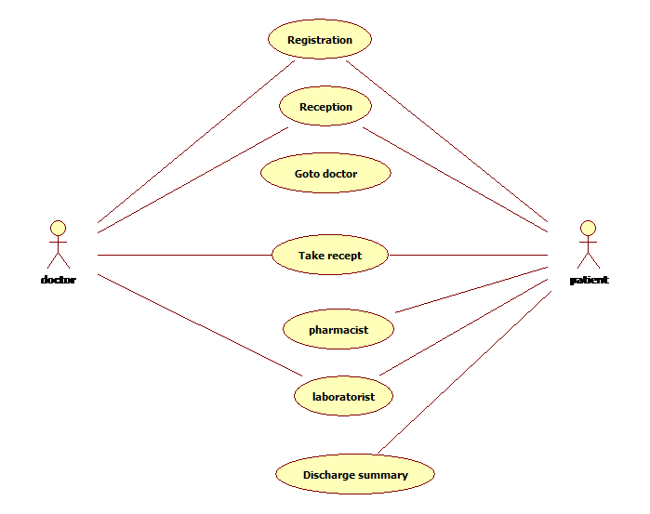
Use Case Diagram of our Project

Slide 7
Class Diagram
A Class is a category or group of things that has similar attributes and common behavior. A Rectangle is the icon that represents the class it is divided into three areas. The upper most area contains the name, the middle; area contains the attributes and the lowest areas show the operations. Class diagrams provides the representation that developers work from. Class diagrams help on the analysis side, too.

Slide 8
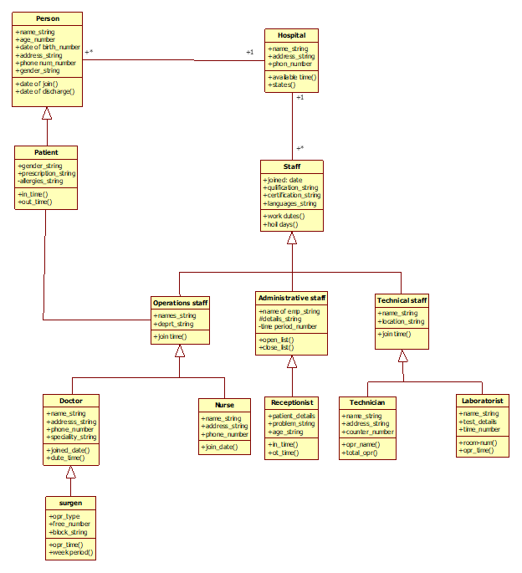

Slide 9
ANALYSIS
EXISTING SYSTEM:
Hospitals currently use a manual system for the management and maintenance of critical information. The current system requires numerous paper forms, with data stores spread throughout the hospital management infrastructure. Often information is incomplete or does not follow management standards. Forms are often lost in transit between departments requiring a comprehensive auditing process to ensure that no vital information is lost. Multiple copies of the same information exist in the hospital and may lead to inconsistencies in data in various data stores.
PROPOSED SYSTEM:
The Hospital Management System is designed for any hospital to replace their existing manual paper based system. The new system is to control the information of patients. Room availability, staff and operating room schedules and patient invoices. These services are to be provided in an efficient, cost effective manner, with the goal of reducing the time and resources currently required for such tasks.

Slide 10
FEASIBILITY STUDY
The feasibility of the project is analysed in this phase and business proposal is put forth with a very general plan for the project and some cost estimates. During system analysis the feasibility study of the proposed system is to be carried out. This is to ensure that the proposed system is not a burden to the company. For feasibility analysis, some understanding of the major requirements for the system is essential.
Three key considerations involved in the feasibility analysis are:
Economic Feasibility:
This study is carried out to check the economic impact will have on the system will have on the organization. The amount of fund that the company can pour into the research and development of the system is limited. The expenditures must be justified. Thus the developed system as well within the budget and this was achieved because most of the technologies used are freely available. Only the customised products have to be purchased.

Slide 11
Technical Feasibility:
This study is carried out to check the technical feasibility, that is,the technical requirements of the system. Any system developed must not have a high demand on the available available technical resources. This will lead to high demands being placed on the client. The developed system must have a modest requirement, as only minimal or null changes for the implementing this system.
Operational Feasibility:
The aspect of study is to check the level of acceptance of the system by the user. This includes the process of training the user to use the system efficiently. The user must not feel threatened by the system, instead must accept it as a necessity. The level of acceptance by the users solely depends on the methods that are employed to educate the user about the system and to make him familiar with it. His level of confidence must be raised so that he is also able to make some constructive criticism, which is welcomed, as he is the final user of the system.

Slide 12
THANK YOU FOR BEING WITH ME

